Slide 1
OPENING A VEGETARIAN Gourmet RESTAURANT IN TORONTO
Christine Brachthäuser

Slide 2
introduction
Growing trend towards high quality, ecologically sound food
Rising appreciation of a pleasant dining culture
Green ideas and lifestyles are increasingly becoming mainstream
Vegetarian cuisine today is sophisticated and splendid
Great opportunities for a vegetarian gourmet restaurant

Slide 3
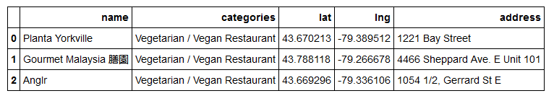
Vegetarian gourmet restaurants in Toronto

Slide 4
Location matters
What are the main target groups and where to find them?
How well does the planned restaurant and the local business environment fit together?

Slide 5
Data used
Toronto Census Data,
available at: https://open.toronto.ca/dataset/neighborhood-profiles/
Foursquare Global Database
access via PLACES API

Slide 6
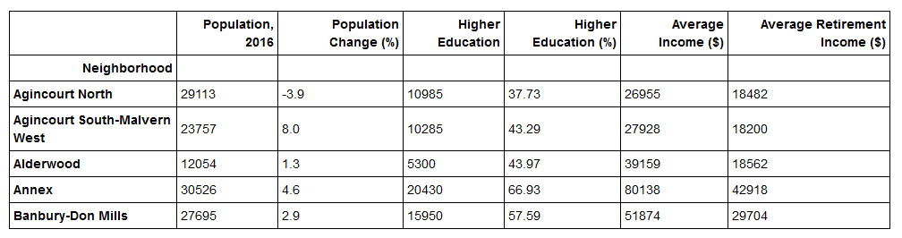
Selected Data from the census data set

Slide 7
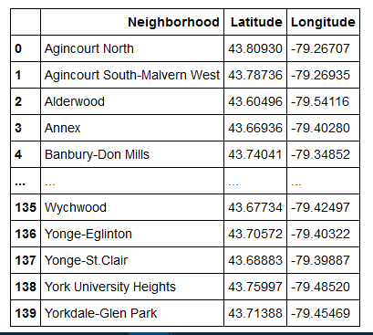
Geodata
Latitude and Longitude Values for all 140 Neighborhoods retrieved with Geocoder.

Slide 8
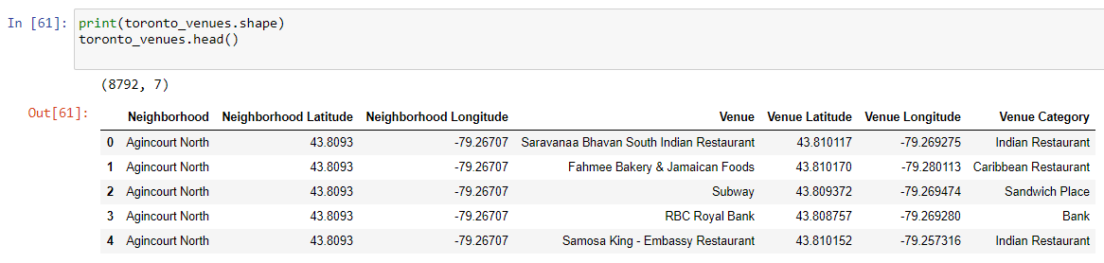
Venue search

Slide 9
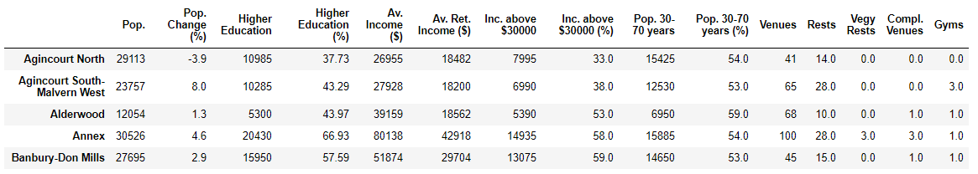
Newly created merged dataframe used for cluster analysis

Slide 10
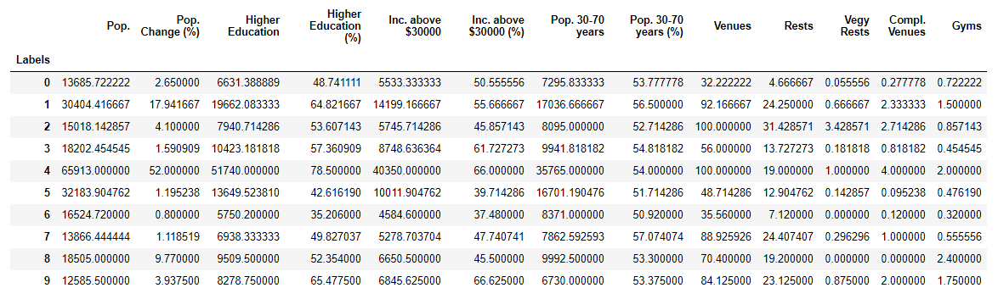
Overview of clusters

Slide 11
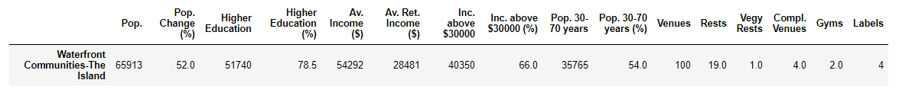
Cluster 4

Slide 12
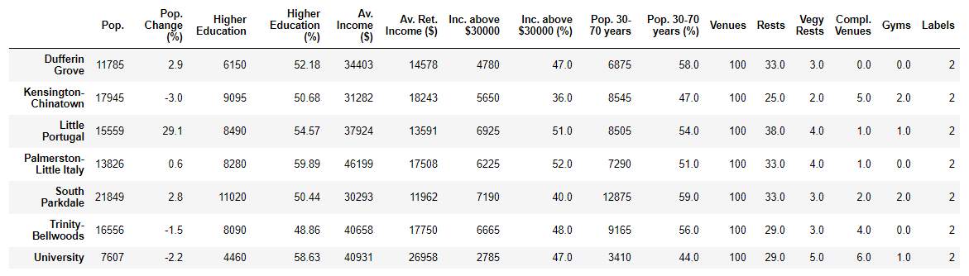
Cluster 2

Slide 13
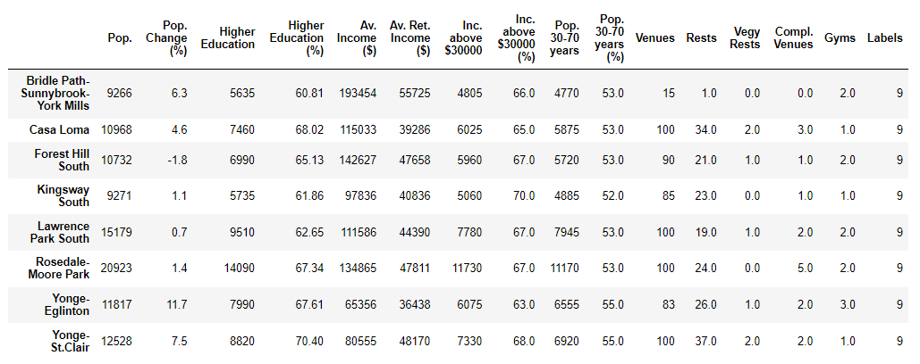
Cluster 9

Slide 14
Plausibility check
Comparing Income and Age Distribution
Waterfront Communities – The Island
Casa Loma
University

Slide 15
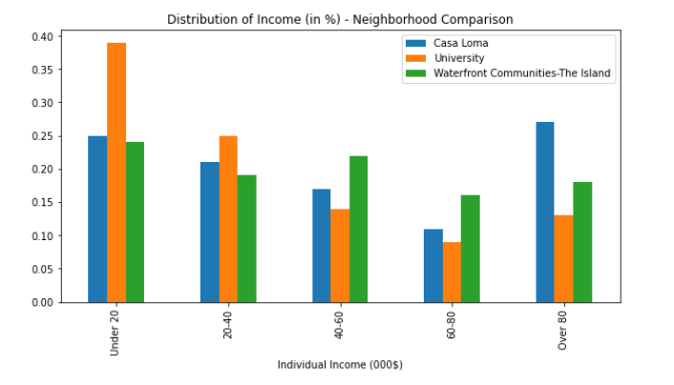

Slide 16
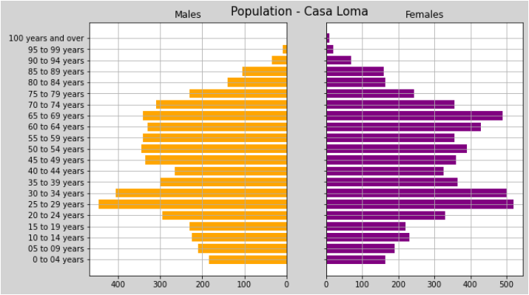
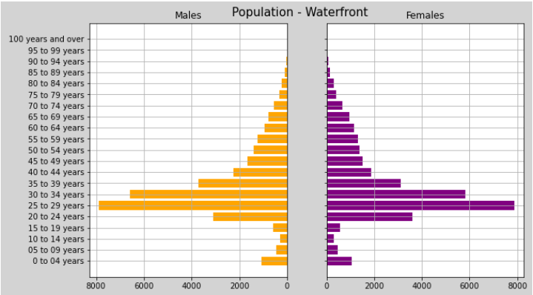

Slide 17
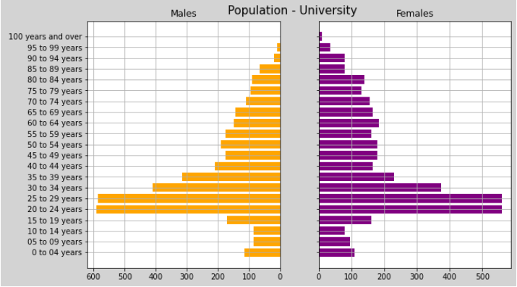
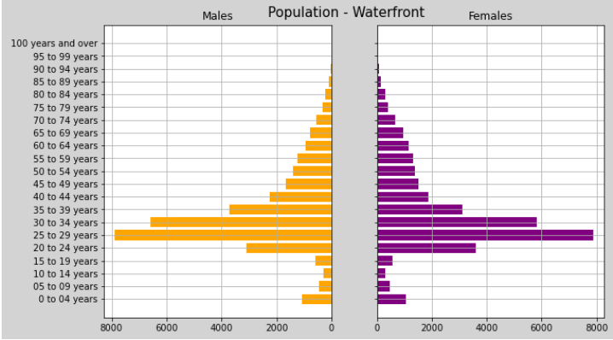

Slide 18
conclusion
Waterfront Communities – The Island a reasonable choice
Cluster analysis as a selection device for business location suitable
Framework flexible enough to include further selection criteria for a truly comprehensive analysis

